Slide 1
Introduction to GeoServer

Slide 2
What Is Geoserver ?
GeoServer is an open-source web mapping server written in Java platform.
It is a subset of a web server model specially designed to share and publish Geographical information over the internet.
It utilizes Web Mapping Service (WMS), Web Feature Service (WFS), Web Coverage Service (WCS) and many other open protocols for transferring Geographical information, such as maps, spatial attributes and Feature data sets.
GeoServer is part of the (backend) and provides and supplies the Web-GIS-Tool with the geodata

Slide 3
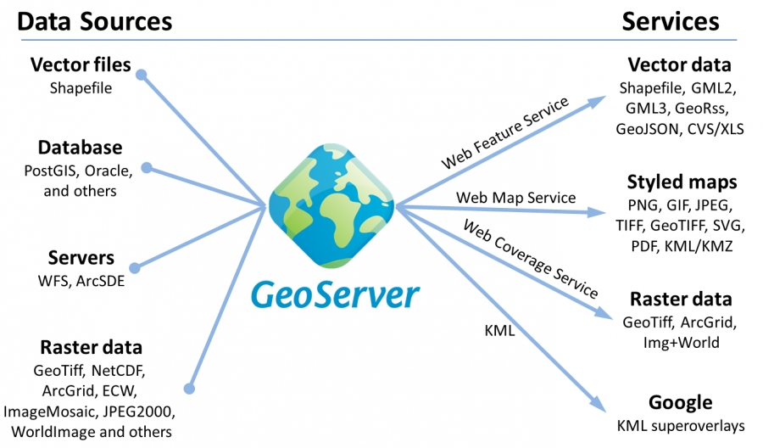
OVERVIEW OF GEOSERVER

Slide 4
WEB MAP SERVICE(WMS)
It provides the map as an Image (png,jpg, etc)
Standard protocol developed by OGC
Available for both raster and vector datasets

Slide 5
WEB FEATURE SERVICE (WFS)
WFS returns features with geometry and attributes that users can utilize in geospatial Analysis

Slide 6
GEOSERVER
GeoServer hierarchy:
Workspace
Store
Layer
Layer Group
Style

Slide 7
WHY USE GEOSERVER
Loading big file in leaflet/openlayer/mapbox ,etc
Creating a webmap for these Layers
Producing OGC Standard Services
Managing Styles for each of these Layers
Managing and organising large number of datasets

Slide 8
WORKSPACE
A workspace is the name for a notional container used to group similar data together.
A workspace consists of a Name and a Namespace URI (Uniform Resource Identifier).
The workspace name should not contain any spaces.

Slide 9
DATA STORE
The data store is a reference to a data source, which contains vector or raster data for publication.
Each store is assigned to a workspace.
A store includes connection parameters to a database or the path to a shapefile for example

Slide 10
LAYERS
Layers are the representations of geodata (vector or raster). Each layer contains several map elements (Features), which can be retrieved as rendered raster data (WMS) or as raw data (WFS or WCS).
Each layer in GeoServer has in common that it has exactly one workspace and exactly one store.
Important Hint: GeoServer automatically creates a WMS and WFS for each layer, a separate creation is not possible.
You can only define in the workspace, if all layers in the current workspace can be received as WMS and WFS, only as WMS or only as WFS.

Slide 11
LAYER GROUP
A Layer Group is a collection of layers.
It contains the information of individual layers and facilitates to request of multiple layers through a single WMS request.
It saves our time, provides easy access to the layers and makes our work smarter.

Slide 12
STYLE
The drawing rule determines the appearance of a layer depending on attribute properties.
GeoServer displays the symbology of a layer with the help of SLD (Styled Layer Descriptor, a XML-based dialect), which can be created or changed in the styles dialog.

Slide 13
Thank You 1

